Slide 1
Deep Learning Packages and resources
Runpeng Dai
The University of North Carolina at Chapel Hill
June 15, 2024
Notes:
It is my pleasure to be here presenting our research on dietary intake data. The goal of the study is to understand the association between cognition and temperament with nutrients and dietary patterns.

Slide 2
Content
1 Introduction to PyTorch basics
2 Setup the colab environment
3 Resources – Hugging-face, Paperwithcode, tensorboard, W&B
Notes:
My presentation will include the following points.

Slide 3
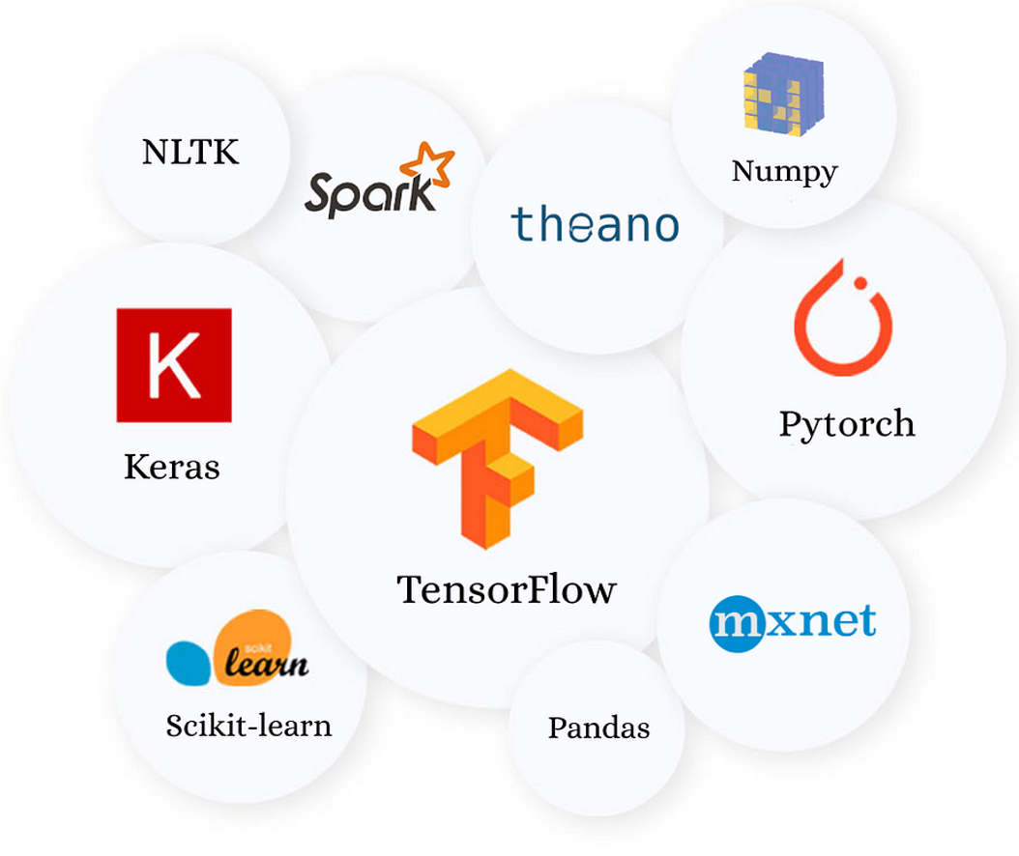
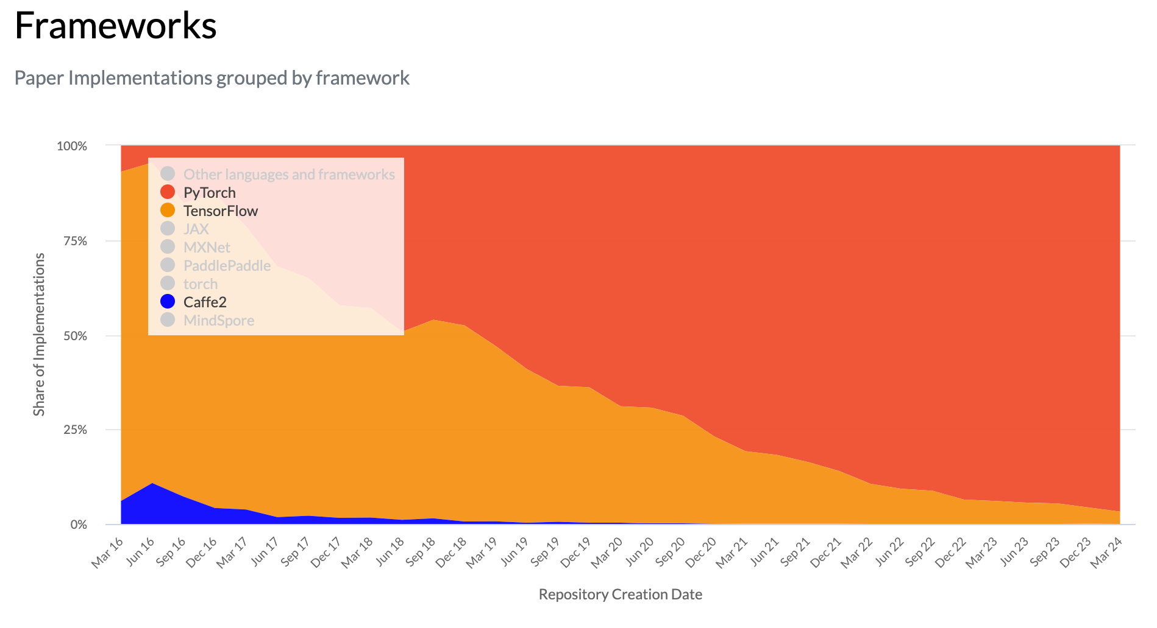
Why Torch?

Slide 4
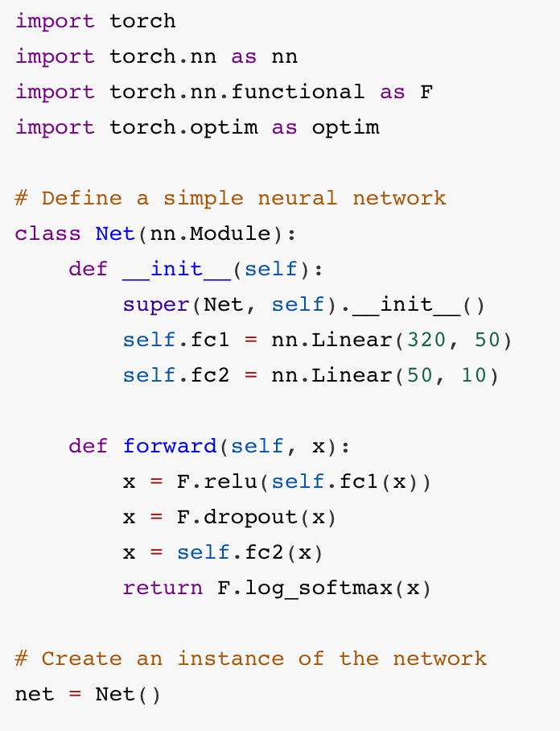
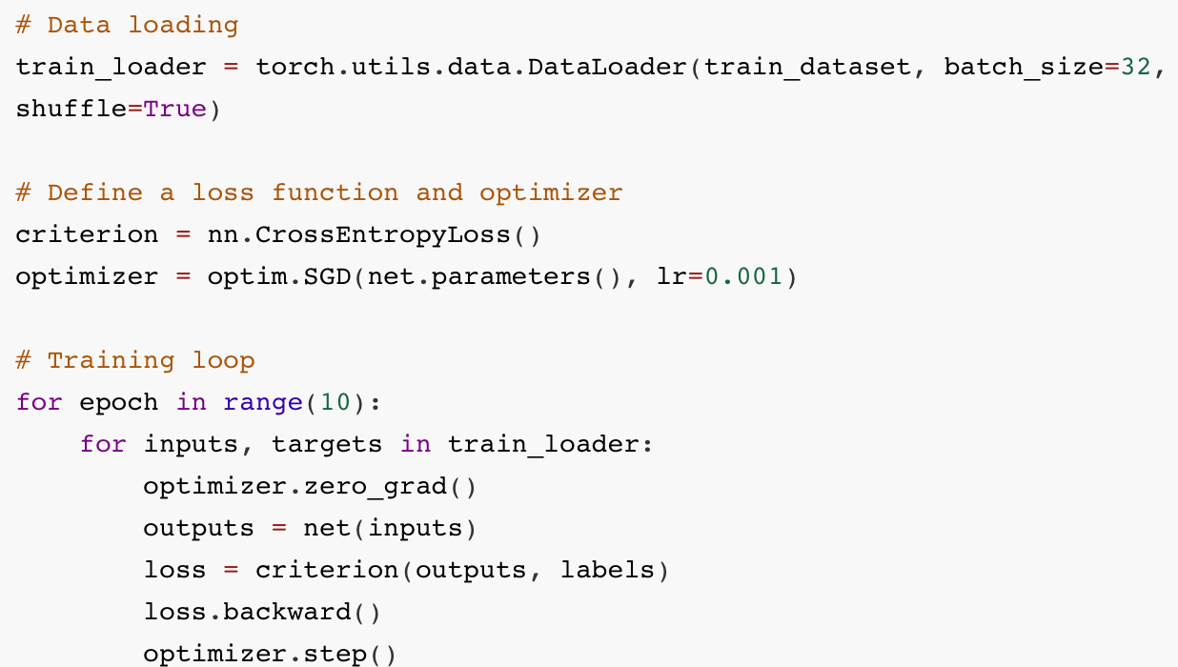
A simple torch code

Slide 5
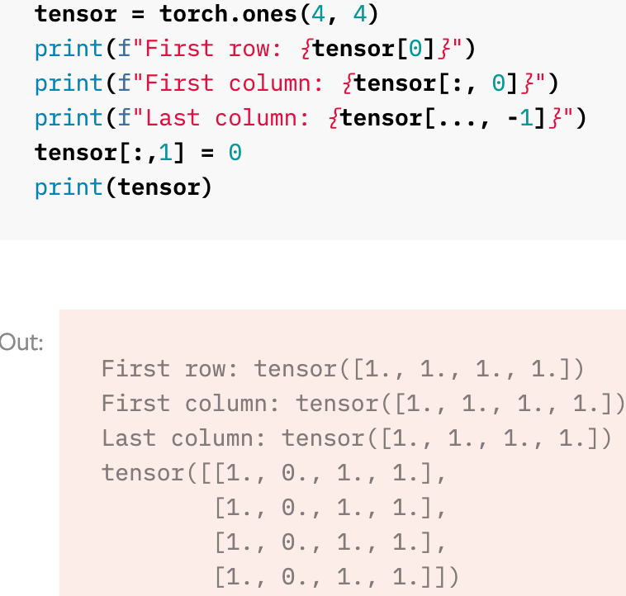
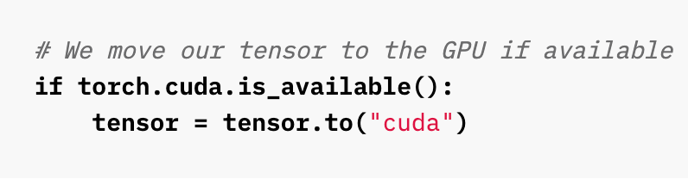
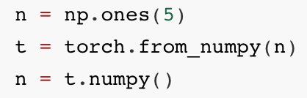
Tensors
Tensors are the core data structures in PyTorch, used to encode inputs and model weights.
While many tensor operations resemble those of NumPy arrays, they are specifically optimized for deep learning and can be transferred to a GPU for accelerated processing.
Numpy style operations
Capability of GPU computing
Easy converting from and to numpy array

Slide 6
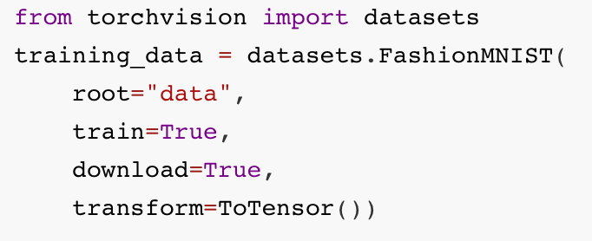
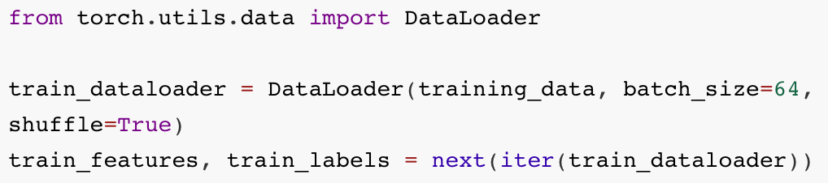
Datasets
Torch can assist in loading and preprocessing datasets (Dataset-Dataloader pipeline). It also provides a number of pre-loaded datasets (e.gMNIST).
Hugging face also have similar module called Datasets.
Loading FashionMNIST
Building a Dataloader
In practice, many researches opt to write their own data processing and sampling code to gain greater flexibility.

Slide 7
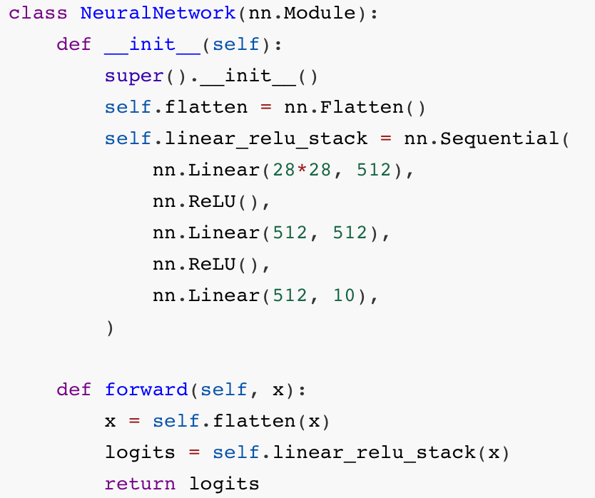
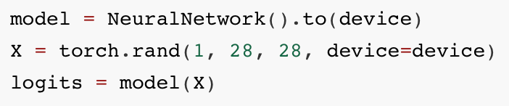
Network structure
The neural network is defined by subclassing nn.Module, the layers are initialized in __init__ and the operations on input data is in forward method.
After instantize the network, the network do forward by passing the input data.
Instantize and send weights to GPU
It is easy to implement normalizing methods (dropout batchnorm etc)

Slide 8
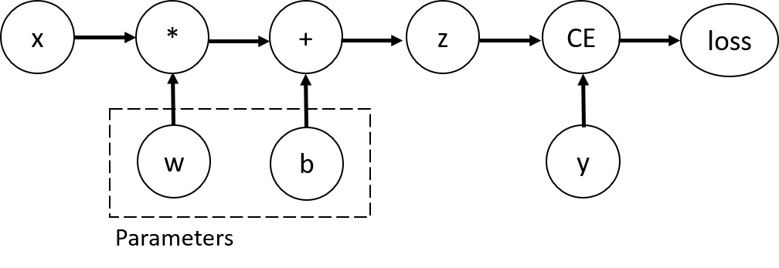
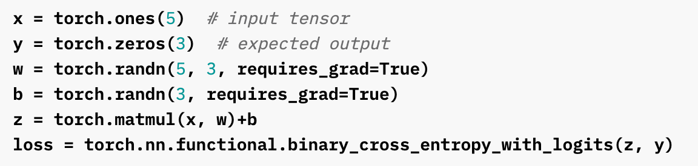
Auto differentiation
When training neural networks, the most frequently used algorithm is gradient descent (and its variants). Pytorch has a built-in engine called autograd for calculating gradients.
- Pytorch have the notion of computation graph.
- Each time do calculations, pytorch store the graph structure(how the final output is related to the tensors that require grad).
- When you use backward to calculate the grad, pytorch calculates the gradient of each component that requires_grad and store it.

Slide 9
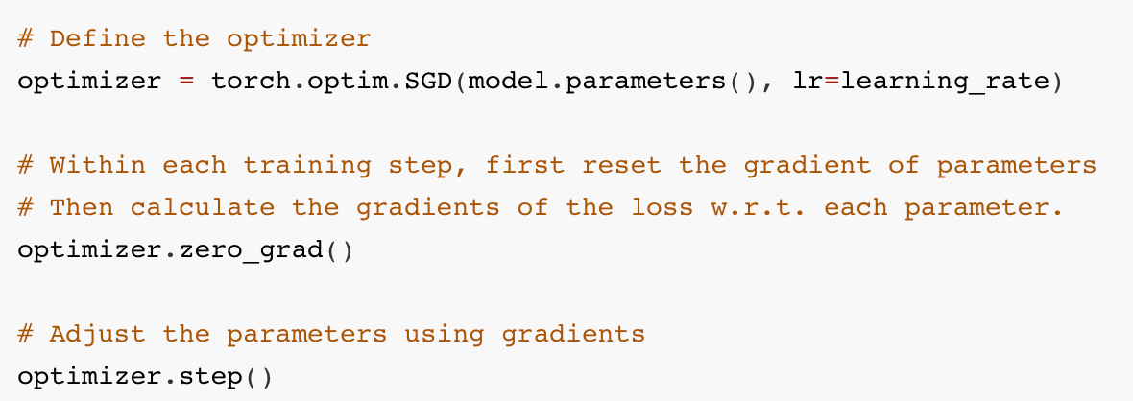
Optimization
Optimization algorithms define how model parameters adjust to reduce model error in each training step.
Many optimization algorithms (e.g. Adam) are available in torch.optim.

Slide 10
Optimization
Optimization algorithms define how model parameters adjust to reduce model error in each training step.
Many optimization algorithms (e.g. Adam) are available in torch.optim.

Slide 11
A simple torch code

Slide 12
Content
1 Introduction to PyTorch basics
2 Setup the colab environment
3 Resources – Hugging-face, Paperwithcode, tensorboard, W&B
Notes:
My presentation will include the following points.

Slide 13
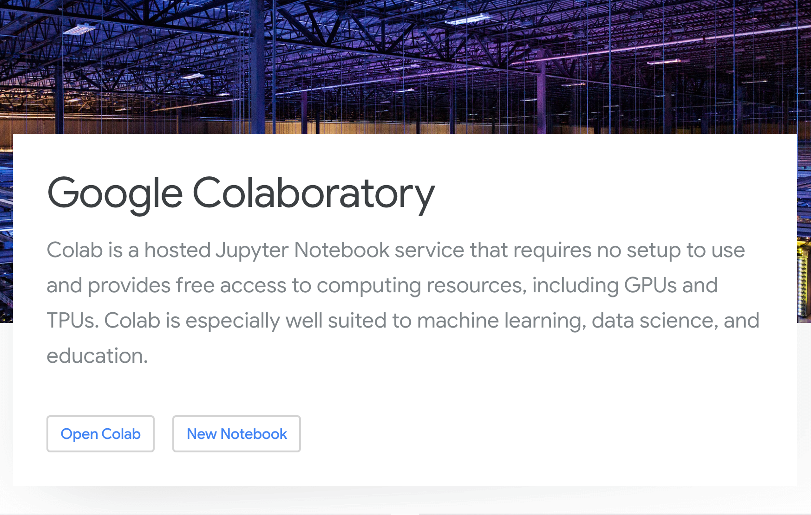
Google Colab
Google Colab, short for Colab, is a free, cloud-based platform provided by Google Research. It allows users to write and execute Python code through a web browser.
One of Colab's key features is the use of Jupyter Notebooks
Colab provides free access to powerful hardware accelerators, including GPUs and TPUs
Colab can mount google drive.

Slide 14
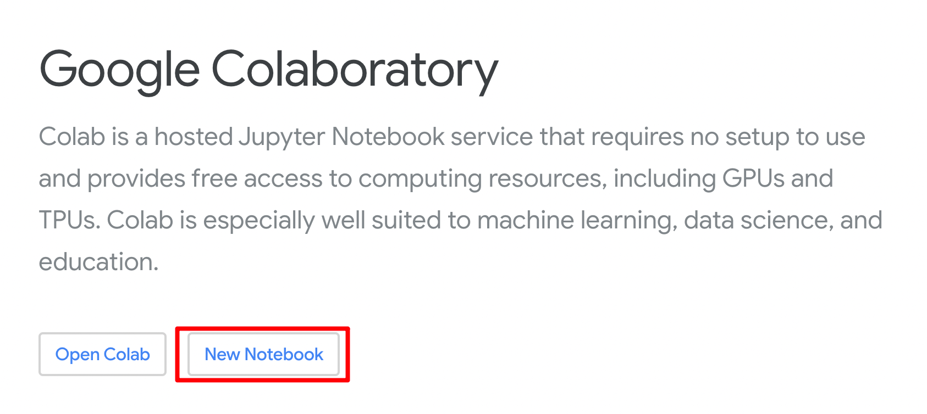
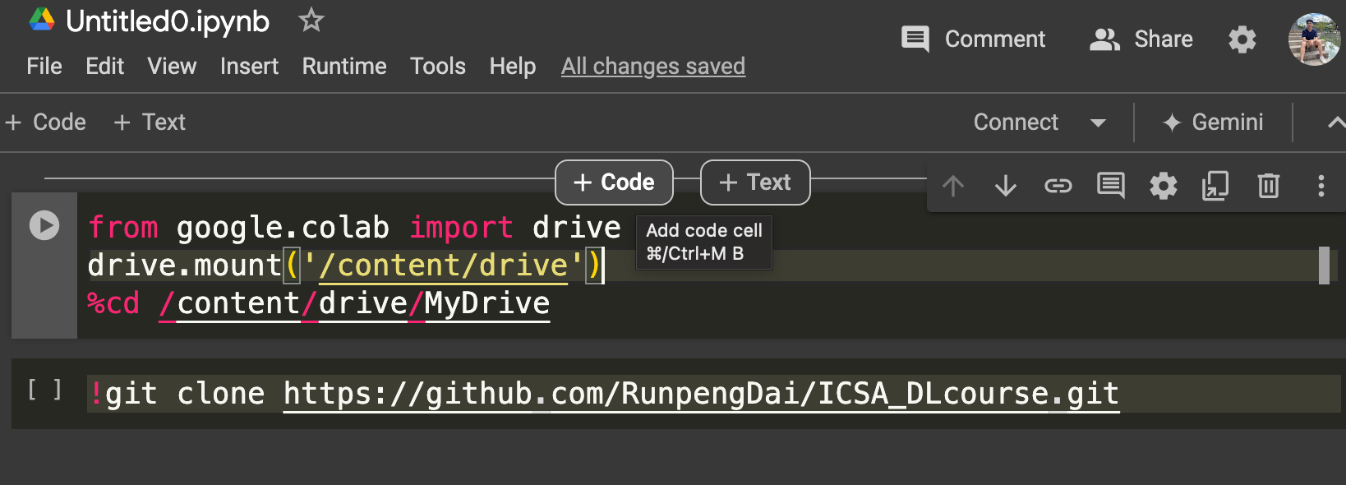
Setup
We offer multiple coding sessions in the short course.
We are going to clone the git repo into Goole drive using commands in colab.
First, create a empty Notebook through https://colab.google/.
Then execute the following code, to mount Google drive to colab and clone our repo to Google drive.
from google.colab import drive
drive.mount('/content/drive')
%cd /content/drive/MyDrive
!git clone https://github.com/RunpengDai/ICSA_DLcourse.git

Slide 15
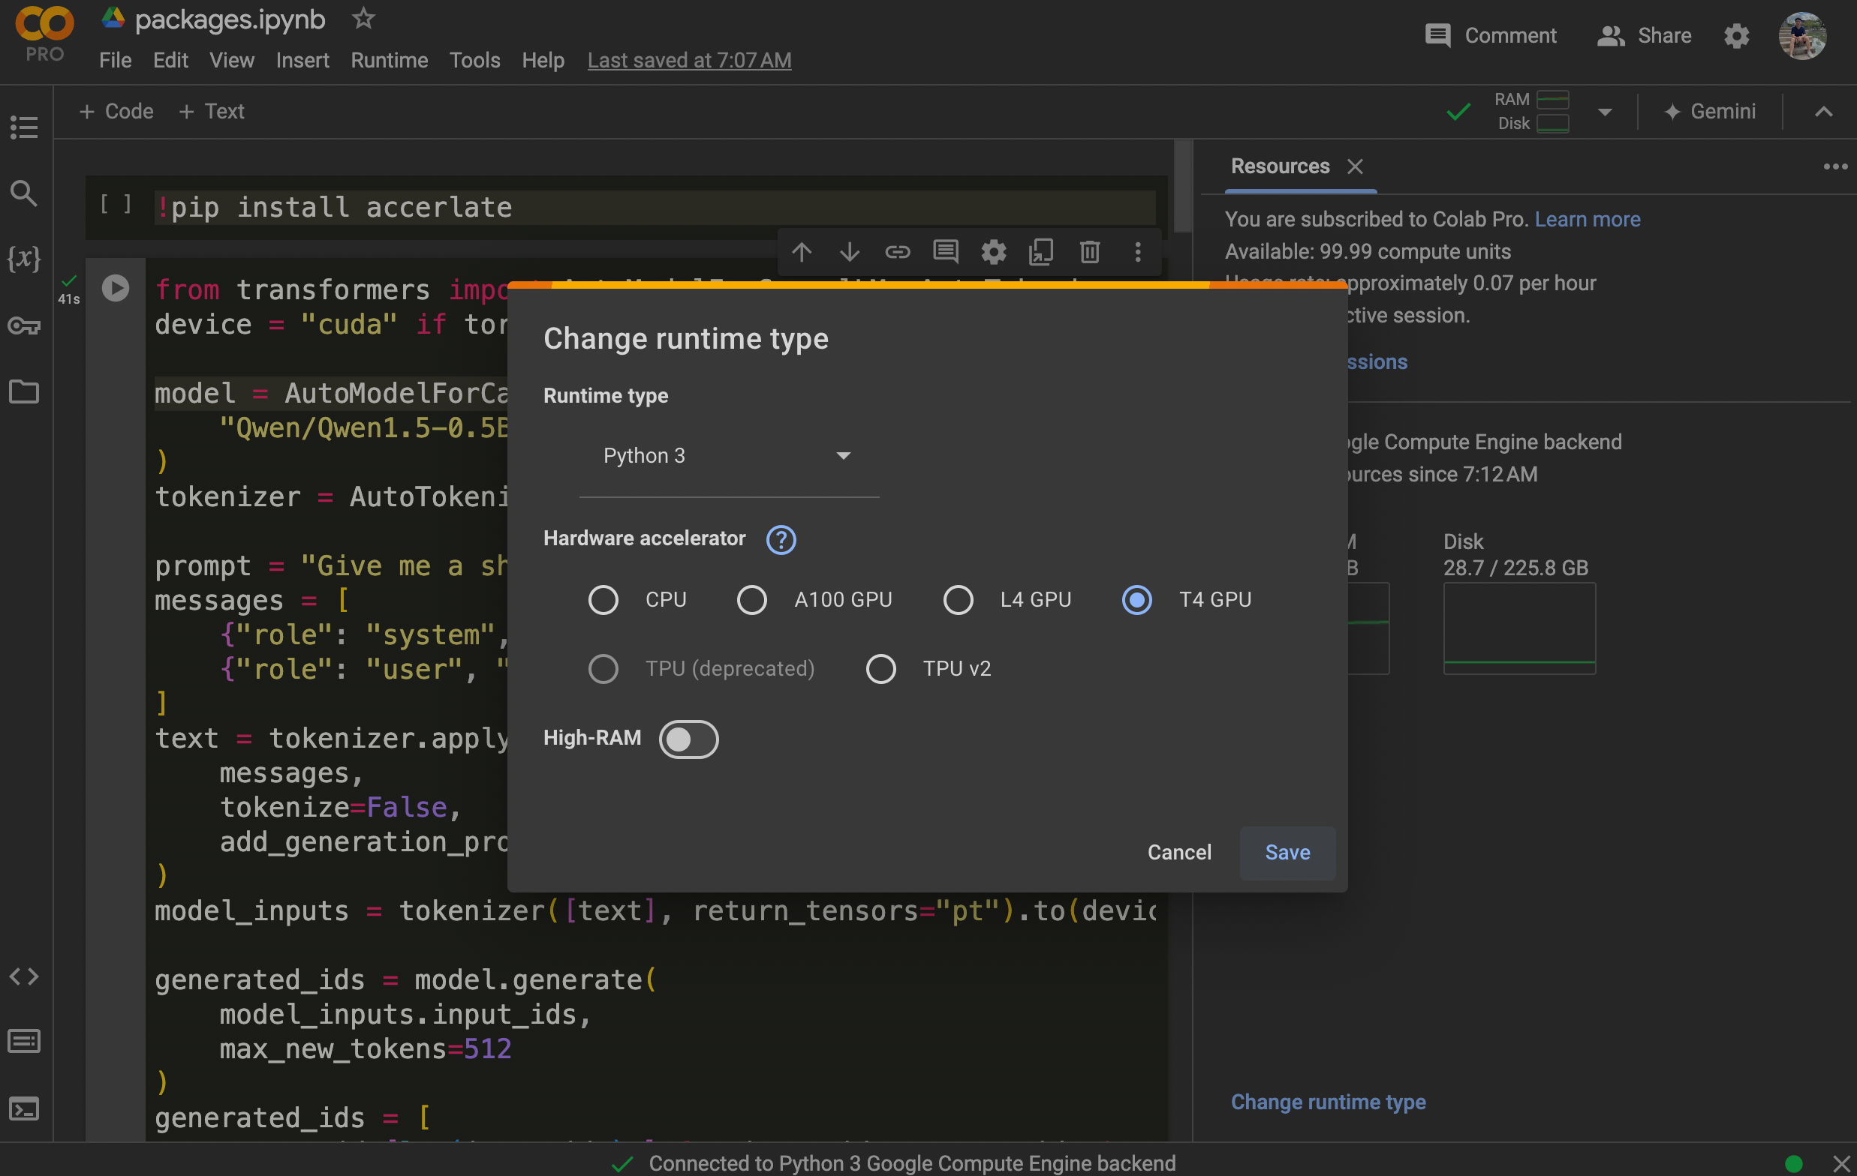
Code session – Pytorch Basics
1.
First open packages.ipynb from the intro folder within Google drive.
Change the runtime type to T4 GPU to have access to GPU computing resource.
2.

Slide 16
Code session – pytorch basics

Slide 17
Content
1 Introduction to PyTorch basics
2 Setup the colab environment
3 Resources – Hugging-face, Paperwithcode, tensorboard, W&B
Notes:
My presentation will include the following points.

Slide 18

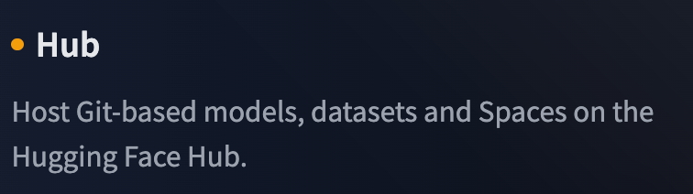
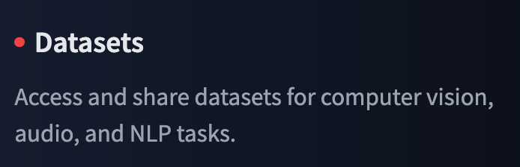

Hugging Face
Hugging face is something you need to know in the era of transformers.
Transformers: A widely known python package providing state-of-the-art implementations of popular transformer based models such as VIT, BERT, GPT (Yes LLM!), and many others.
Model Hub: A place where users share pretrained models. Especially pretrained large language models.
Datasets: A library providing a wide range of datasets for different machine learning tasks.

Slide 19
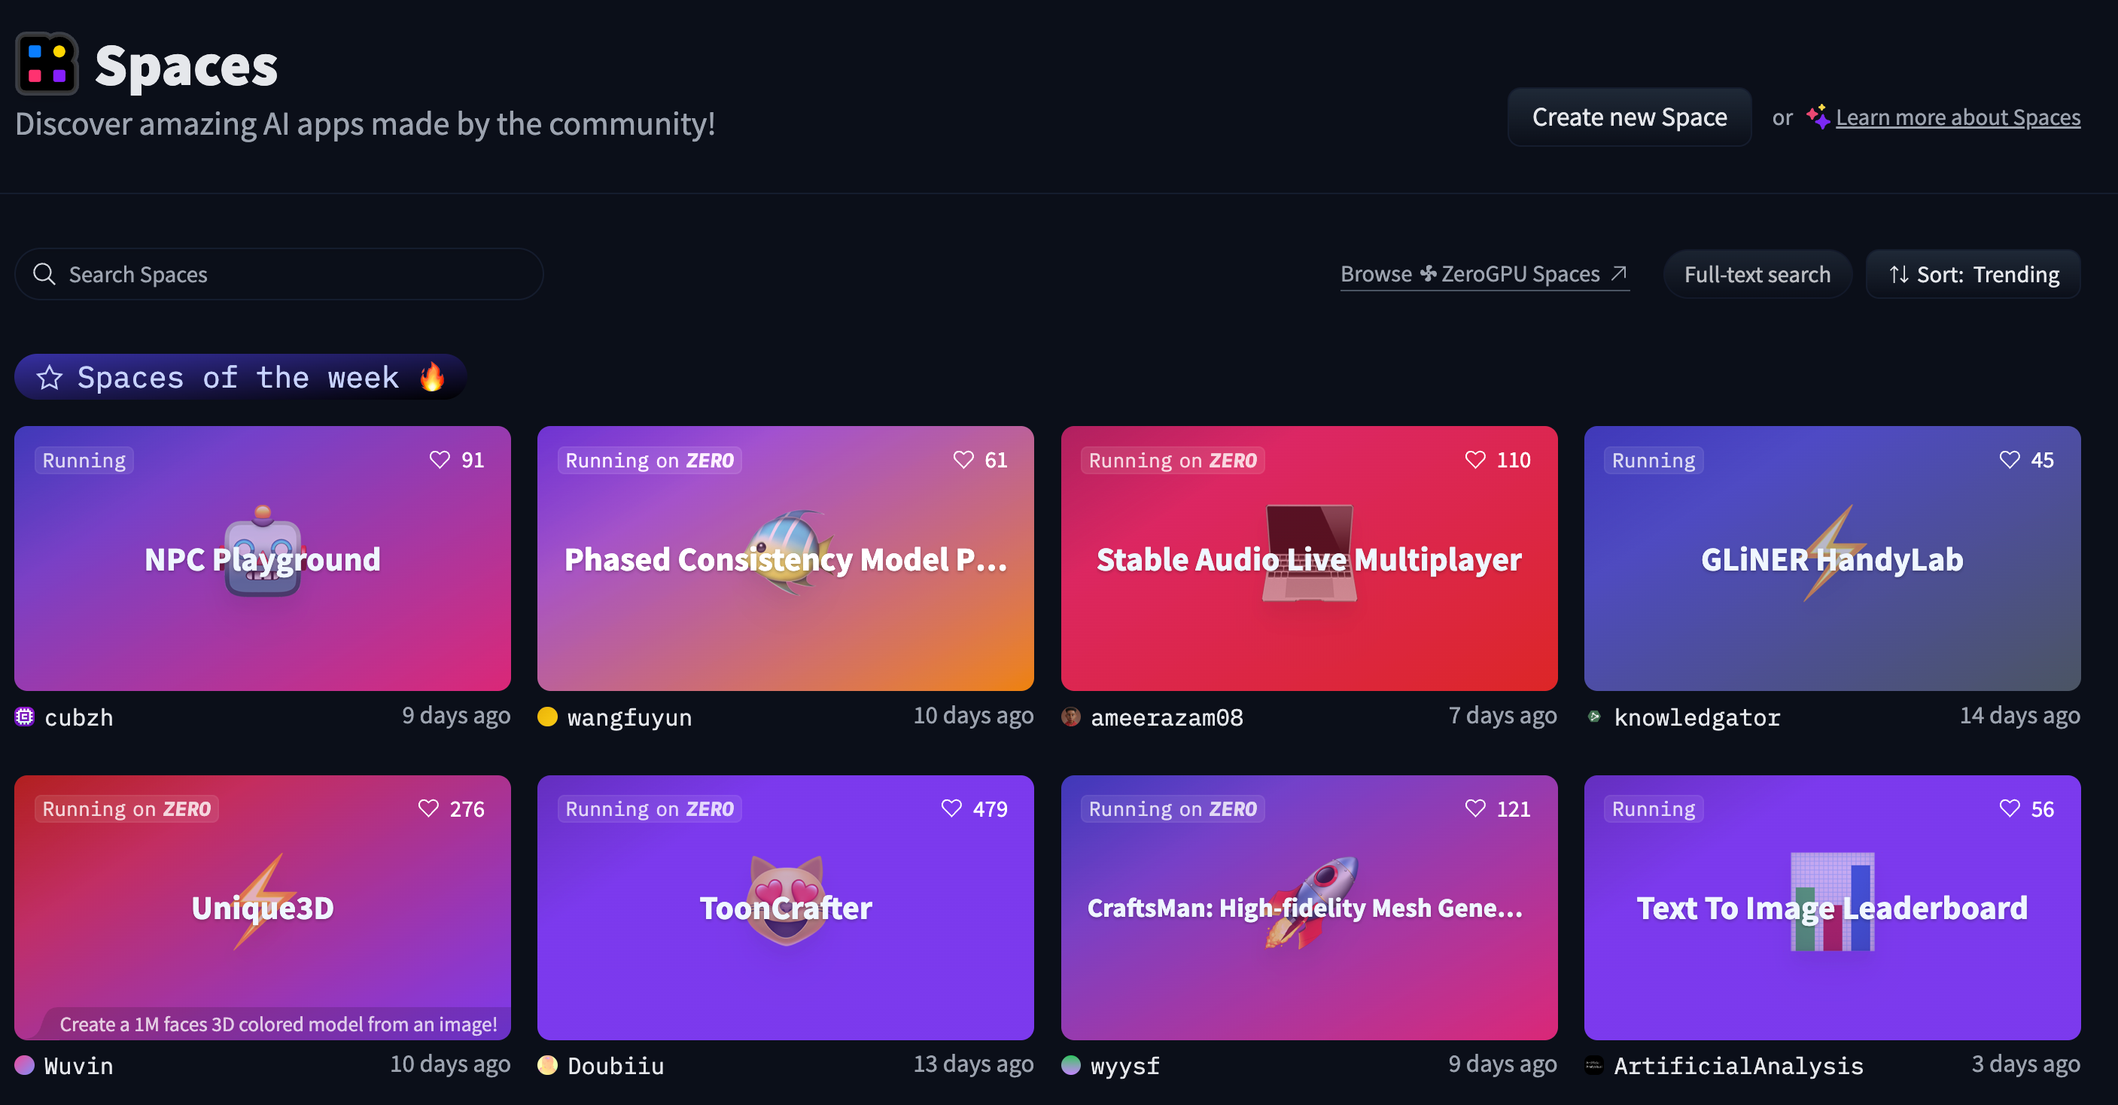
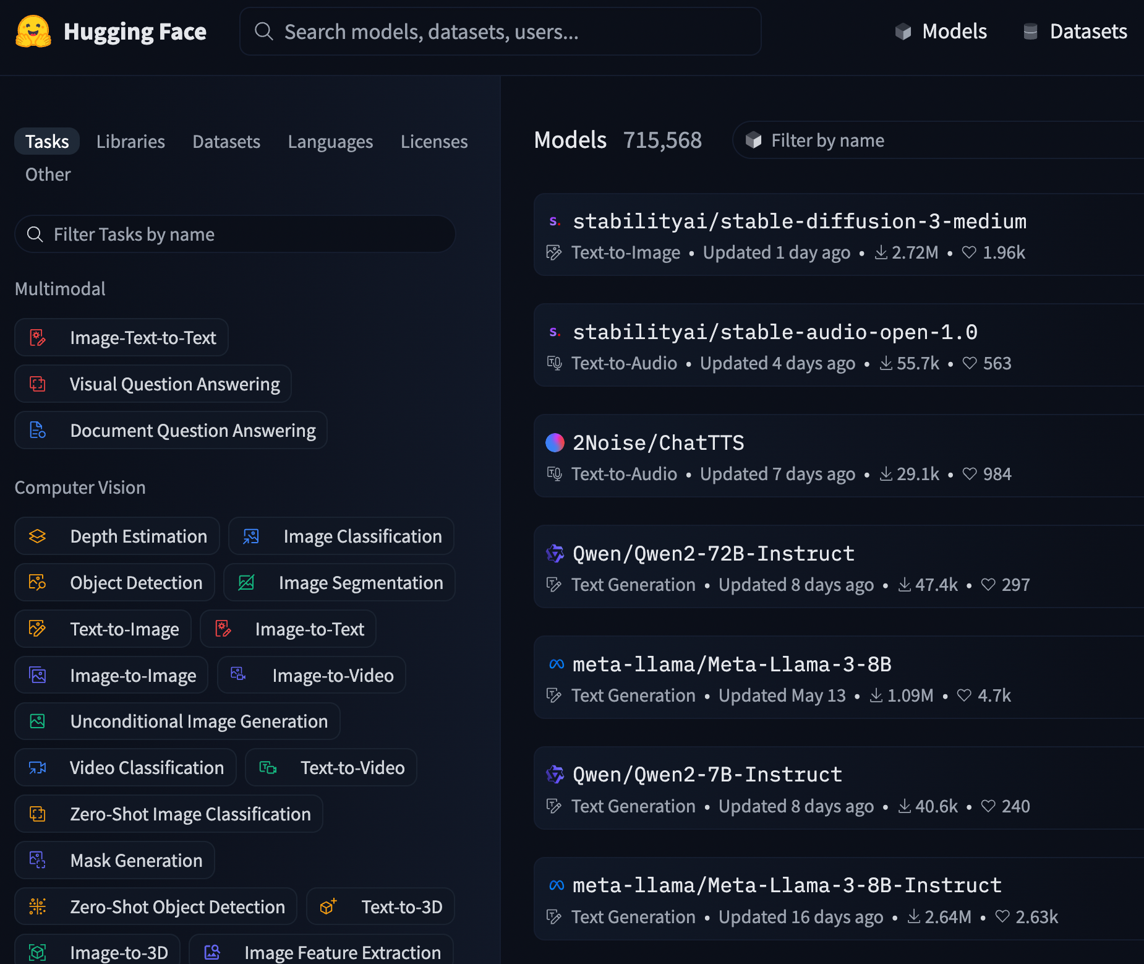
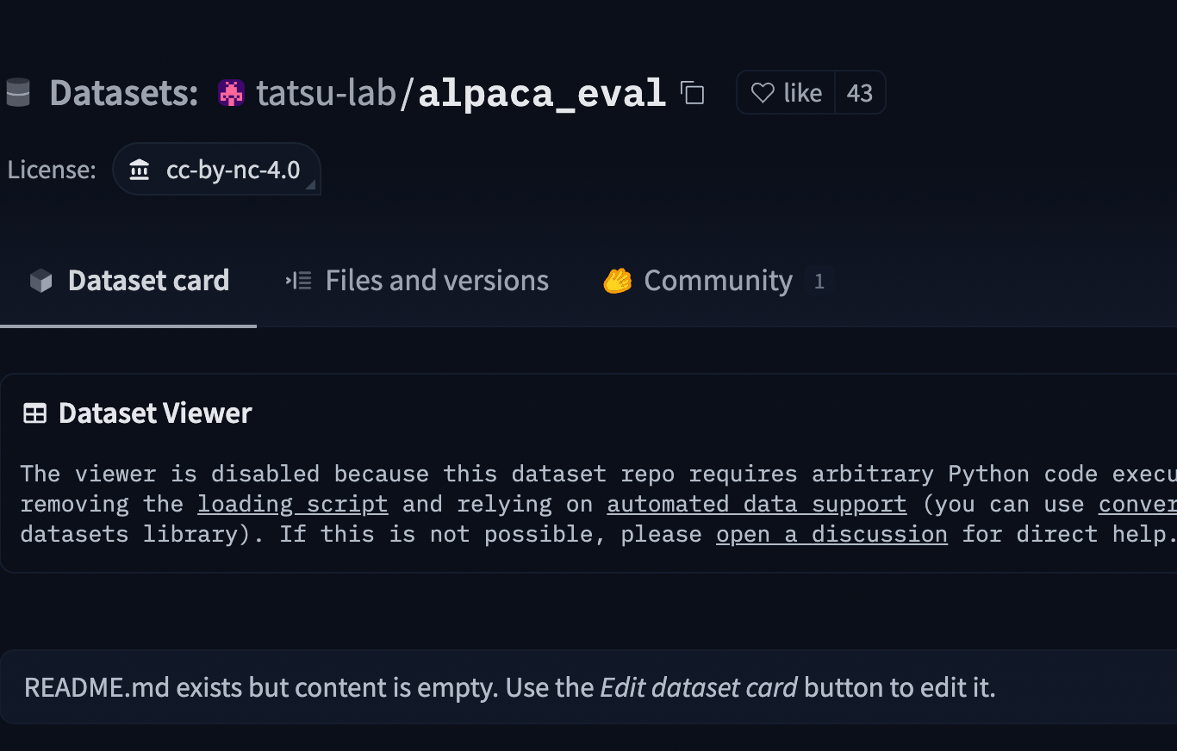
Hugging Face

Slide 20
Code session – Hugging face and LLM

Slide 21
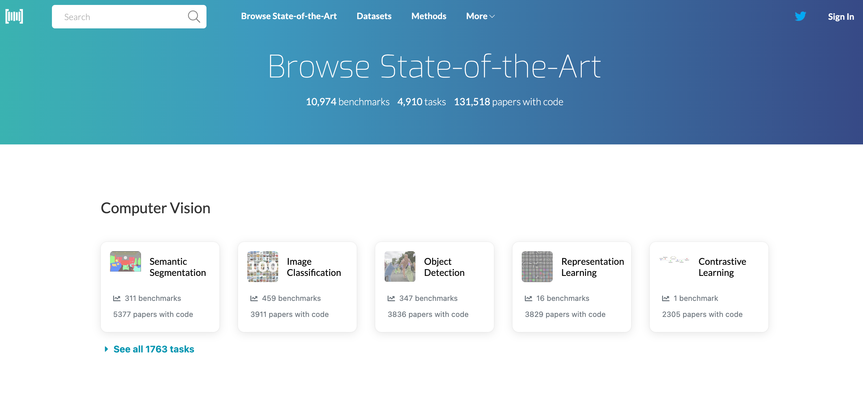
Paper with code
Papers with Code is a platform that integrates academic research papers with their corresponding code implementations.
Researchers and developers can explore state-of-the-art models, datasets, and benchmarks

Slide 22
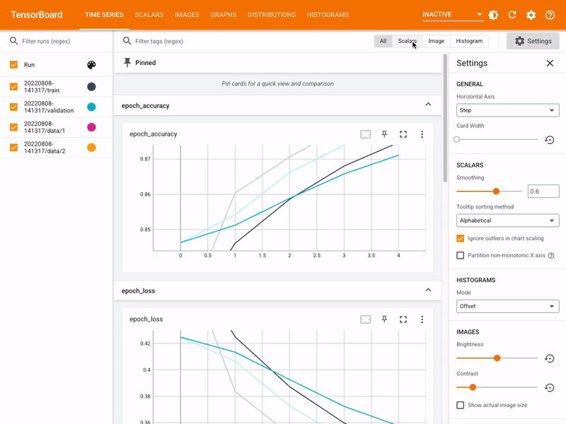
TensorBoard
TensorBoard is an interactive visualization tool. It is used to monitoring the training and testing process and select hyper parameters.
It offers more flexibility than tqdm.

Slide 23
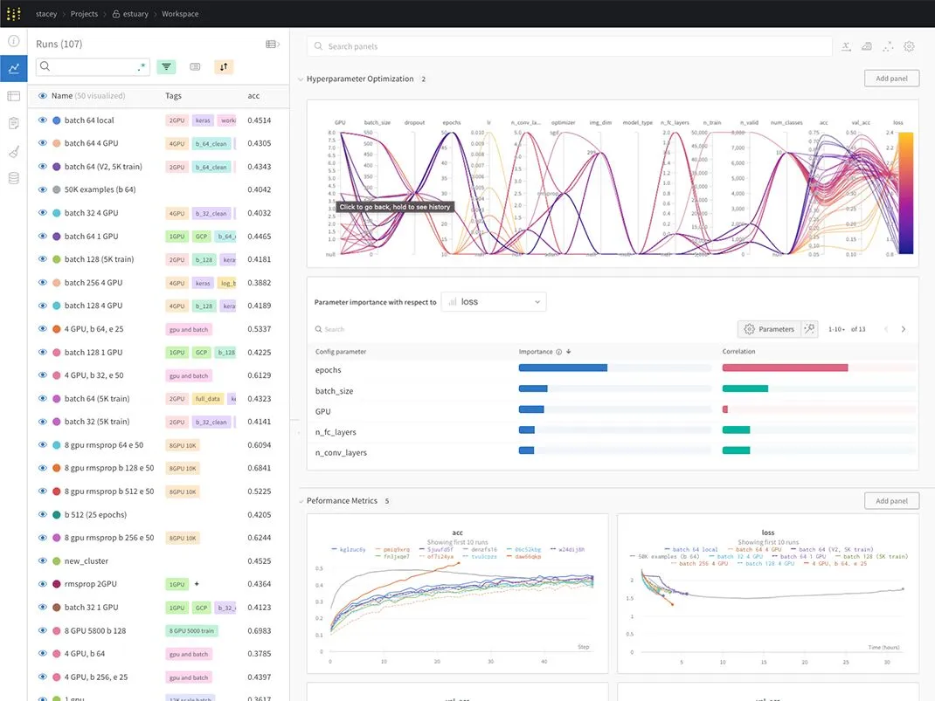
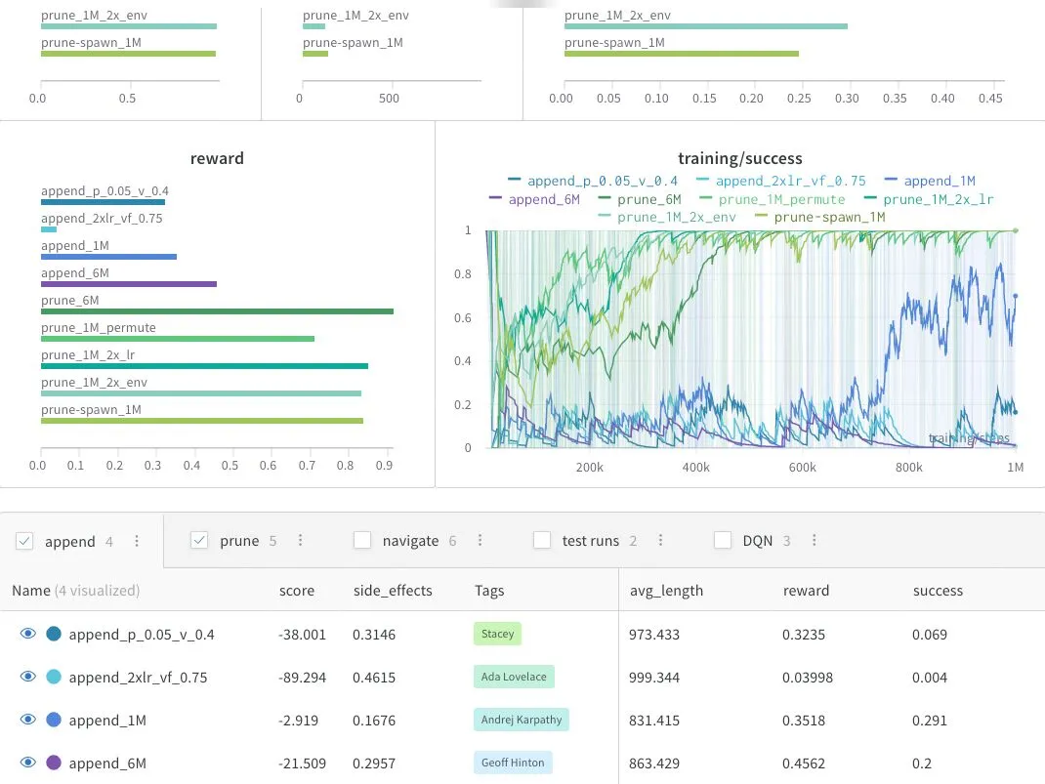
Weights and bias

